Slide 1
FINANCIAL MANAGEMENT
Presenting by,
Mr. LAXMAN GANGARAM APPUGOL
(RESEARCH SCHOLAR)
UGC NET(Qualified for Assistant Prof.) AND SET

Slide 2
Introduction
Financial Management: Meaning and scope- objectives of Financial Management-role and functions of finance managers. Interface of Financial Management with other functional areas.
Indian Financial System: Structure-types-Financial markets- Financial Instruments -Financial institutions and financial services- Non-Banking Financial Companies (NBFCs).
Emerging areas in Financial Management: Risk Management- Behavioural Finance- Financial Engineering- Derivatives (Theory).

Slide 3
MEANING AND DEFINITION :
Meaning : Financial management is the operational activity of a business that is responsible for obtaining and effectively utilizing the funds necessary for efficient business operations. It usually deals with financial planning, acquisition of funds, use and allocation of funds and financial controls.
Financial management I a specialized branch of management which is concerned with planning, obtaining and effectively utilizing the firm’s financial resources.
According to J. F. Bradley, “Financial management is the area of business management devoted to the judicious use of capital & careful selection of sources of capital in order to enable a spending unit to move in the direction of reaching its goals.”
According to J.L. Massie, “financial management is the operational activity of a business that is responsible for obtaining and effectively utilizing the funds necessary for efficient business operations.”

Slide 4
SCOPE OR CONTENT OF FINANCE FUNCTION/FINANCIAL MANAGEMENT :
1. Estimating Financial Requirements
2. Deciding Capital Structure
3. Selecting Source of Finance
4. Selecting Pattern of Investment
5. Proper Cash Management
6. Implementing Financial Controls
7. Proper Use of Surpluses

Slide 5
NATURE OF FINANCIAL MANAGEMENT :
1. Specialised Branch of General Management
2. Integral Part of Management
3. Both an Art as well as a Science
4. Growing as a Profession
5. Multidisciplinary Approach
6. Involves Risk-Return Trade off
7. Focus on Valuation of the Firm
8. Organic Function
9. Attainment of Common Objectives of a Firm
10. Backbone of Commerce and Industry

Slide 6
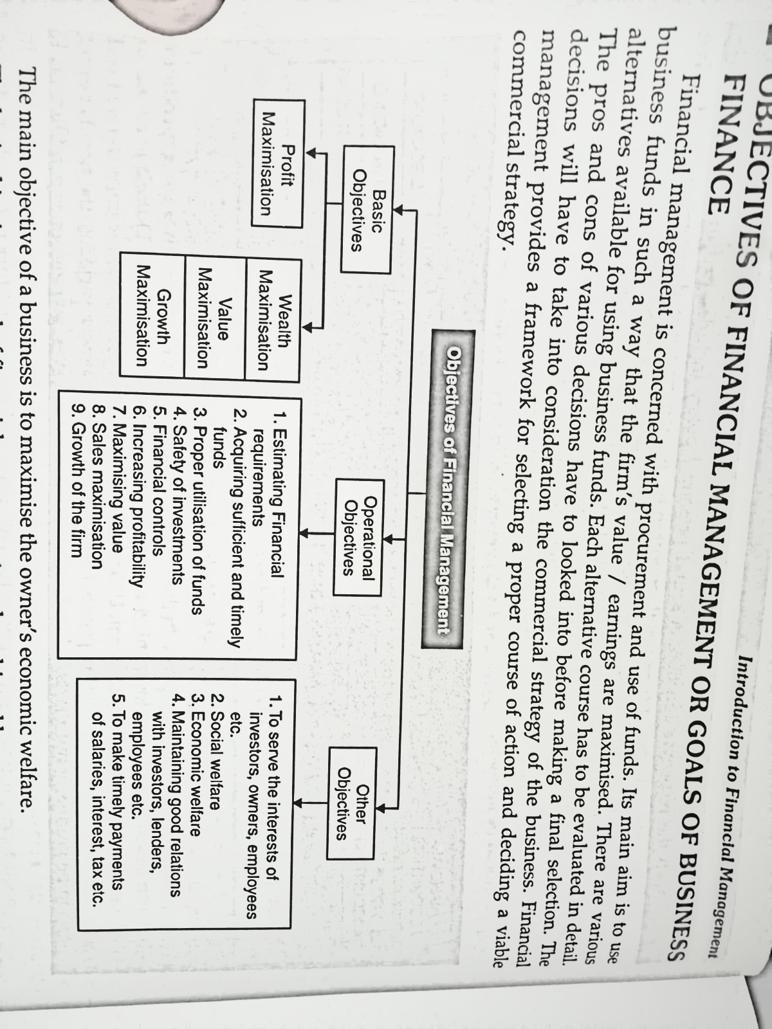

Slide 7
ROLE OR FUNCTIONS OF FINANCE MANAGER :
1. Financial Forecasting and Planning.
2. Acquisition of Funds.
3. Investment of Funds.
4. Helping in Valuation Decisions.
5. Maintain Proper Liquidity.
6. Management of Cash, Receivables and Inventory.
7. Disposal of Surplus.
8. Performance Evaluation and Financial Control.
9. Tax Planning.

Slide 8
Interface of Financial Management with other functional areas :
Financial Management
Purchase function
Production Function
Marketing/ Distribution function
Accounting Function
Personnel Function
Research and Development Function

Slide 9
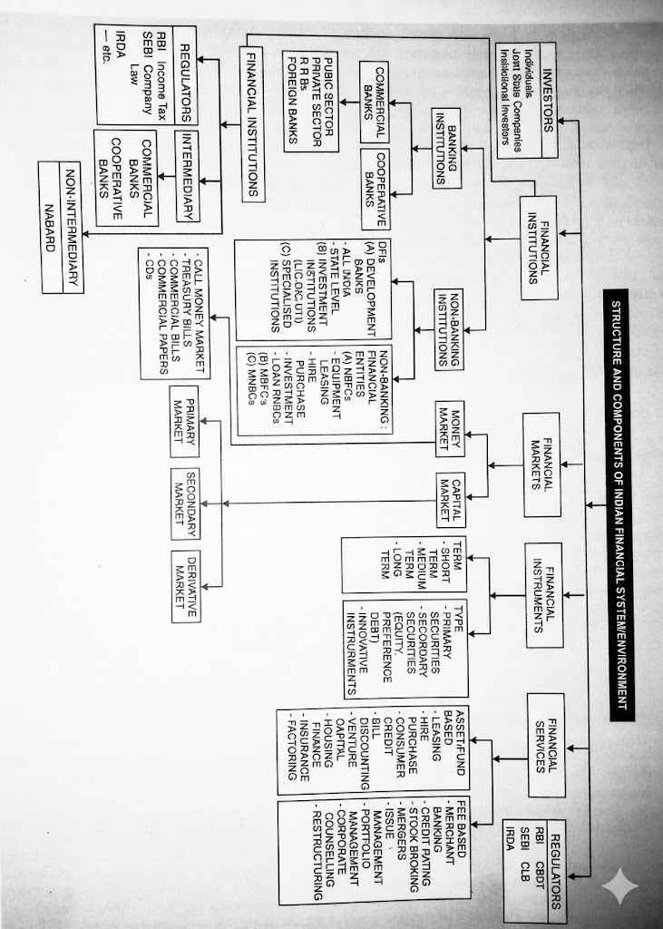

Slide 10
FINANCIAL INSTITUTIONS
Regulators
Intermediary
RBI
SEBI
IRDA
BANKING INSTITIUTIONS
COMMERCIAL BANKS
COOPERATYIVE BANKS
NON BANKING INSTITUTIONS
NON INTERMEDIARY
NABARD
Public Sector
Private Sector
RRBs
Foreign Banks
DFIs
(A) DEVELOPMENT BANKS
- ALL INDIA
- STATE LEVEL
(B) INVESTMENT INSTITUTIONS
(LIC,GIC,UTI)
(C) SPECIALISED INSTITUTIONS
lNON-BANKING:
FINANCIAL ENTITIES
(A) NBFCs
- EQIUPMENT
LEASING
- HIRE
PURCHASE
-INVESTMENT
- LOAN RNBCS
(B) MBFC's
(C) MNBCS

